Slide 1
CIS8695 Managing Big Data Analytics
Nasim Mousavi
Assistant Professor
J. Mack Robinson College of Business
Georgia State University
nmousavi@gsu.edu

Slide 2
Decision Tree Overview

Slide 3
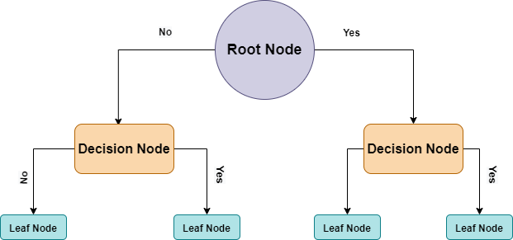
Decision Trees
Decision tree is a simple classifier
A flow-chart-like tree structure
Decision node denotes a test on an attribute
Branch represents an outcome of the test
Terminal (Leaf) nodes represent class labels or class distribution

Slide 4
Trees & Rules
Goal: Classify or predict an outcome based on a set of predictors
Trees are based on separating records into subgroups by creating splits on predictors
These splits create logical rules
For example: IF Age<55 AND Education>12 THEN Class=1

Slide 5
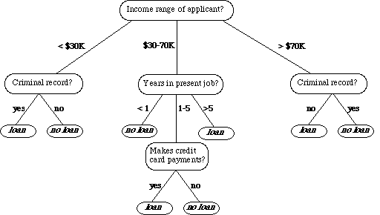
Example
Bank wants to predict which customers it should give a loan

Slide 6
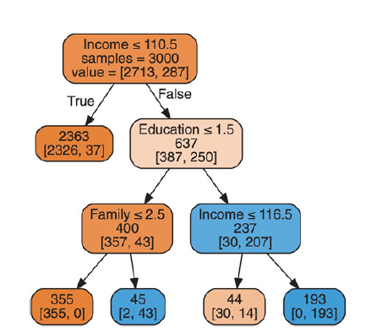
Example
Decision Nodes (with successors)
Branches (with number of cases)
Terminal Nodes (Leaves) (with class noted)
Class is defined based on majority vote

Slide 7
Example
categorical
categorical
continuous
class
Refund
Yes
No
NO
MarSt
Single, Divorced
Married
TaxInc
NO
< 80K
> 80K
NO
YES
Training Data
Model: Decision Tree

Slide 8
Decision Tree Classification Task
Decision Tree

Slide 9
Apply Model to Test Data
Test Data
Start from the root of tree.
Refund
Yes
No
NO
MarSt
Single, Divorced
Married
TaxInc
NO
< 80K
> 80K
NO
YES

Slide 10
Apply Model to Test Data
Test Data
Refund
Yes
No
NO
MarSt
Single, Divorced
Married
TaxInc
NO
< 80K
> 80K
NO
YES

Slide 11
Apply Model to Test Data
Test Data
Refund
Yes
No
NO
MarSt
Single, Divorced
Married
TaxInc
NO
< 80K
> 80K
NO
YES

Slide 12
Apply Model to Test Data
Test Data
Refund
Yes
No
NO
MarSt
Single, Divorced
Married
TaxInc
NO
< 80K
> 80K
NO
YES

Slide 13
Apply Model to Test Data
Test Data
Refund
Yes
No
NO
MarSt
Single, Divorced
Married
TaxInc
NO
< 80K
> 80K
NO
YES

Slide 14
Apply Model to Test Data
Test Data
Refund
Yes
No
NO
MarSt
Single, Divorced
Married
Assign Cheat to “No”
TaxInc
NO
< 80K
> 80K
NO
YES

Slide 15
Recursive Partitioning

Slide 16
How Is a Tree Produced?
Recursive partitioning: Repeatedly split the records into two parts so as to achieve maximum homogeneity of outcome within each new part

Slide 17
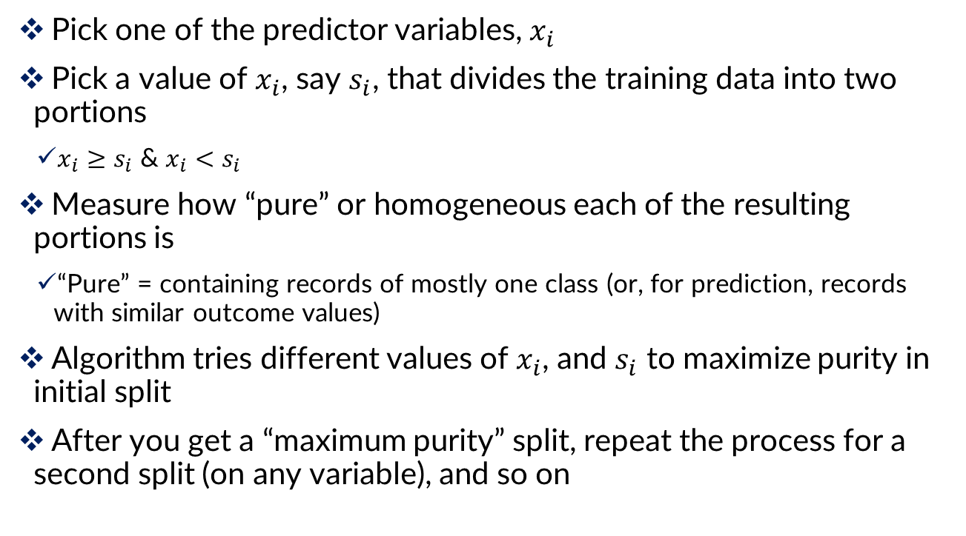
Recursive Partitioning
Pick one of the predictor variables, $x_{i}$
Pick a value of $x_{i}$, say $s_{i}$, that divides the training data into two portions
$x_{i}≥s_{i}$ & $x_{i}<$ $s_{i}$
Measure how “pure” or homogeneous each of the resulting portions is
“Pure” = containing records of mostly one class (or, for prediction, records with similar outcome values)
Algorithm tries different values of $x_{i}$, and $s_{i}$ to maximize purity in initial split
After you get a “maximum purity” split, repeat the process for a second split (on any variable), and so on

Slide 18
Example: Riding Mowers
Goal: Classify 24 households as owning or not owning riding mowers
Predictors = Income, Lot Size

Slide 19
Example: How to Split?
Order records according to one variable, say income
Take a predictor value, say 59.7 (the first record) and divide records into those with income >= 59.7 and those < 59.7
Measure resulting purity (homogeneity) of class in each resulting portion
Try all other split values
Repeat for other variable(s)
Select the one variable & split that yields the most purity

Slide 20
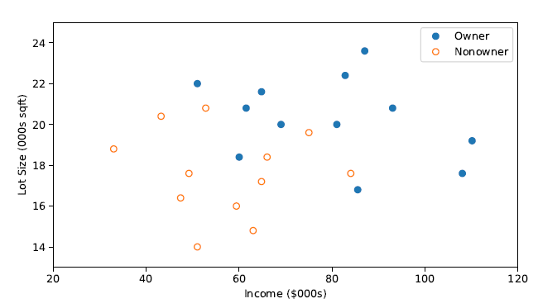
Example: Riding Mowers

Slide 21
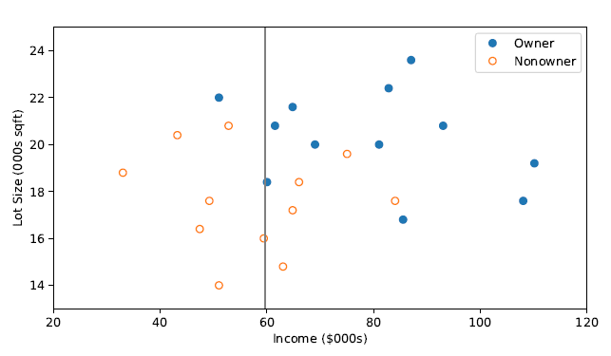
The First Split: Income=59.7
Take a predictor value, say 59.7 (the first record) and divide records into those with income >= 59.7 and those < 59.7

Slide 22
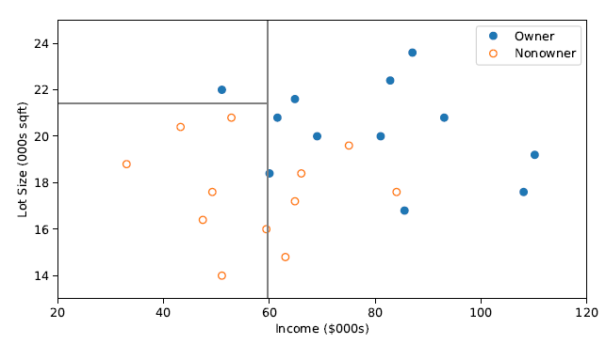
The Second Split: Lot Size=21.4
Take another predictor value, lot size =21.4 and divide records into those with size >= 21.4 and those < 21.4

Slide 23
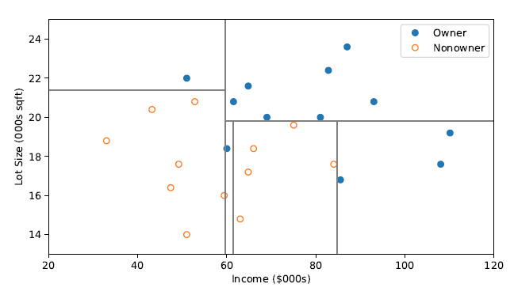
After All Splits
More splits again based on lot size, like 19.8 & income, like 61.5 & 84.7, until we have a desirable purity in each rectangle

Slide 24
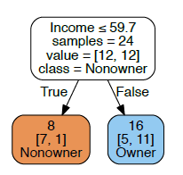
First Split – The Tree

Slide 25
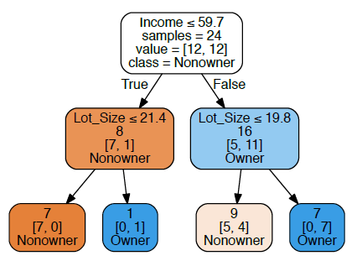
Tree After 3 Splits
The first split is on Income, then the next split is on Lot Size for both the low income group (at lot size 21.4) and the high income split (at lot size 19.8)

Slide 26
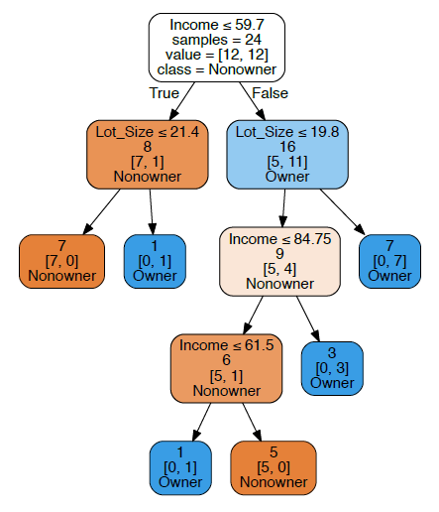
Tree After All Splits
Decision node
Terminal node (leaf)

Slide 27
The dominant class in this portion of the first split (those with income >= 59.7) is “owner” – 11 owners and 5 non-owners
The next split for this group of 16 will be on the basis of Income, splitting at 84.75

Slide 28
Read Down the Tree to Derive Rules
If Income <= 59.7 AND
Lot Size <= 21.4,
classify as “Nonowner”

Slide 29
Remember: How to Split?
Order records according to one variable, say income
Take a predictor value, say 59.7 (the first record) and divide records into those with income >= 59.7 and those < 59.7
Measure resulting purity (homogeneity) of class in each resulting portion
Try all other split values
Repeat for other variable(s)
Select the one variable & split that yields the most purity

Slide 30
Measuring Impurity

Slide 31
How to Determine the Best Split
Nodes with homogeneous class distribution are preferred
Subsets that contain instances with similar values
Need a measure of node impurity:
Non-homogeneous,
High degree of impurity
Homogeneous,
Low degree of impurity

Slide 32
Impurity Measurements
Gini Index
Entropy Measure

Slide 33


Impurity Measurement: Gini Index
Gini Index for a rectangle A
$p_{k}$ = proportion of records in rectangle A that belong to class k (out of m classes)
Complete purity: I(A) = 0 when all cases belong to same class
Complete impurity: Max value when all classes are equally represented (= 0.50 in binary case)

Slide 34

Impurity Measurement: Entropy
The entropy for the rectangle A
p = proportion of cases in rectangle A that belong to class k (out of m classes)
Entropy ranges between 0 (most pure) and log₂(m) (equal representation of classes)

Slide 35
Example: Riding Mowers

Slide 36
The First Split: Income=59.7

Slide 37

Impurity Measurement
Left rectangle: 7 nonowners & 1 owner

Slide 38

Impurity Measurement
Right rectangle: 11 owners & 5 nonowners

Slide 39

Impurity Measurement
Left rectangle: 7 nonowners & 1 owner
Right rectangle: 11 owners & 5 nonowners
The combined impurity of the two nodes is the weighted average of the two impurity

Slide 40
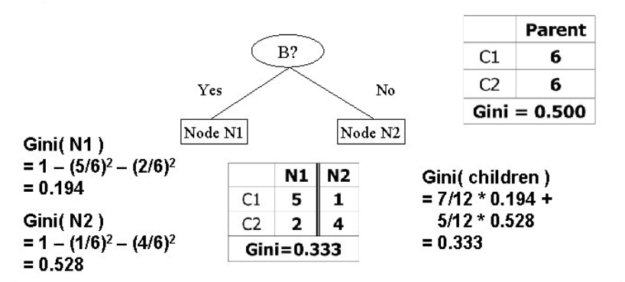
Another Example

Slide 41
Impurity & Recursive Partitioning
Age | Income | Credit Rating | Student | Credit Card Default
Youth | High | Excellent | No | No
Middle | Low | Fair | No | Yes
… | … | … | … | …
Suppose we have this training dataset, which variable to split first?

Slide 42
Impurity & Recursive Partitioning
Obtain overall impurity measure (weighted avg. of individual rectangles)
At each successive stage, compare this measure across all possible splits in all variables
Choose the split that reduces impurity the most
Chosen split points become nodes on the tree

Slide 43
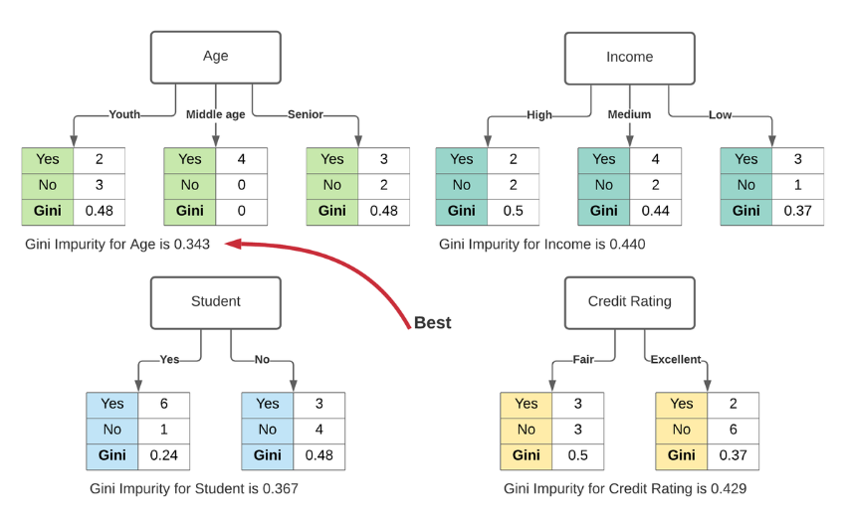
Impurity & Recursive Partitioning

Slide 44
Performance Evaluation

Slide 45
Trees Can be Unstable
Small variations in the data might result in a completely different tree being generated
If 2 or more variables are of roughly equal importance, which one CART chooses for the first split can depend on the initial partition into training and validation
A different partition into training/validation could lead to a different initial split
This can cascade down and produce a very different tree from the first training/validation partition
One of the solutions is to try many different training/validation splits – “cross validation”

Slide 46
Cross-Validation (CV)
Partition data into sets (folds) for model-fitting, and data for evaluating
Fit model with training fold, and evaluate with holdout fold
Repeat, typically with evaluation folds that are non-overlapping and smaller than training folds
e.g. 5-fold CV fits 5 models, each evaluated on 20% of the data that is held out, with each set of evaluation data non-overlapping with the others

Slide 47
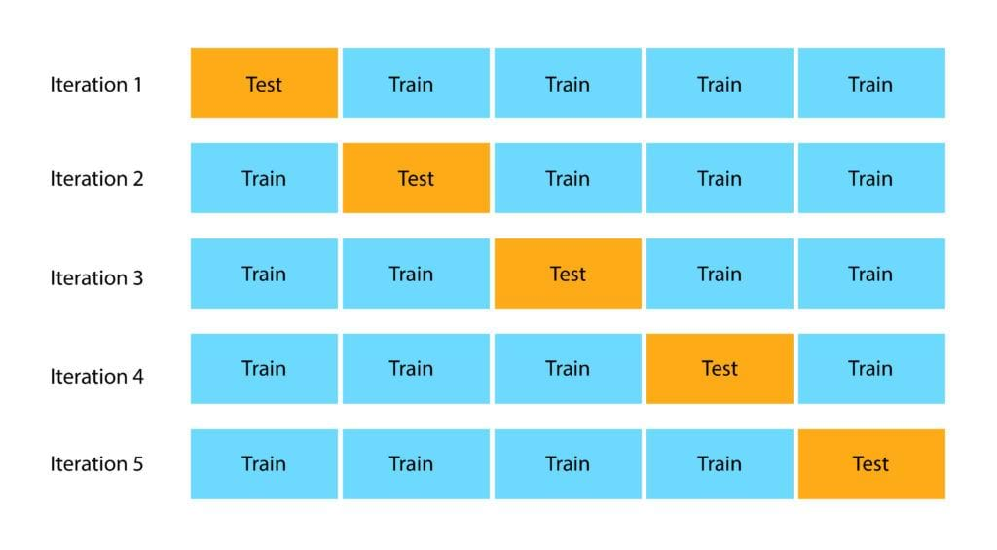
Cross-Validation (CV=5)

Slide 48
The Overfitting Issue

Slide 49
The Overfitting Problem
Natural end of process is 100% purity in each leaf
This overfits the data, which end up fitting noise in the data
Consider the Loan Acceptance example with more records and more variables than the Riding Mower data – the full tree is very complex

Slide 50
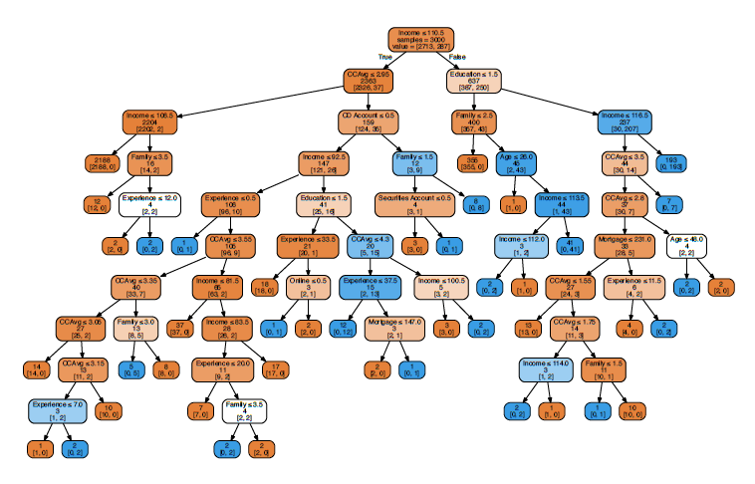
The Overfitting Problem

Slide 51
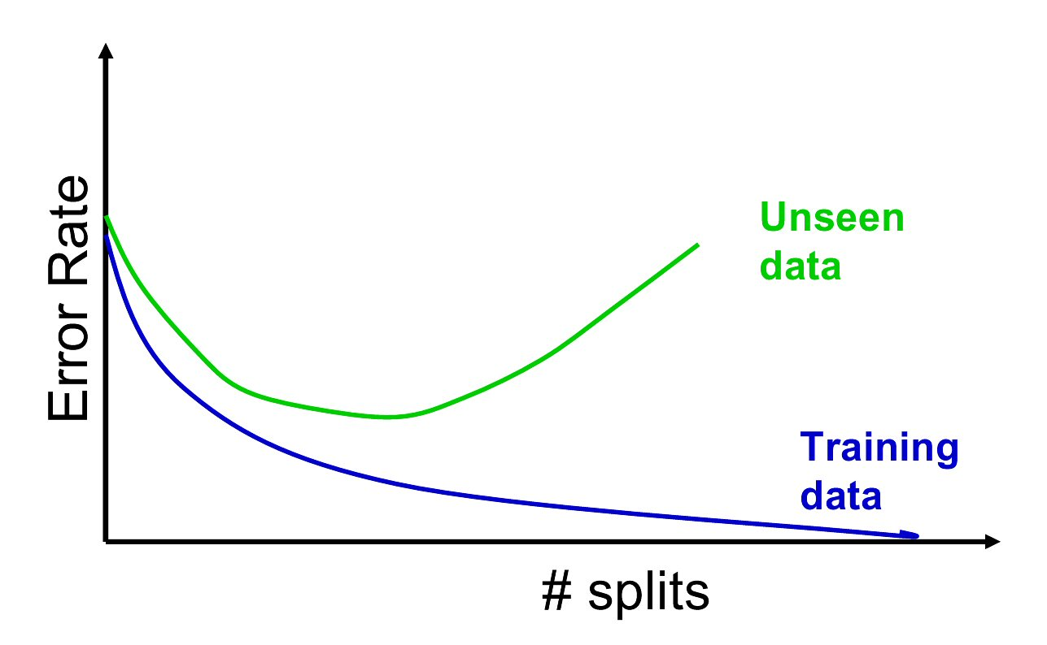
The Overfitting Problem
Overfitting & instability produce poor predictive performance – past a certain point in tree complexity, the error rate on new data starts to increase

Slide 52
Different Approaches to Tackle this Issue!
We can strop tree growth by:
Controlling for the depth of trees
Determining the minimum number of records in split nodes
Determining the minimum number of records in terminal node
Determining the minimum impurity increase needed
However, it is not easy to determine what is a good stopping point!
What are optimal values for these parameters?
Solution: Use grid search over combinations of different parameters value

Slide 53
Exhaustive Search With Cross-Validation
Using exhaustive (grid) search on training data, coupled with cross-validation:
Exhaustively build trees using different values for the parameters, using the training data
Measure accuracy on the holdout (validation) data
Choose tree with best performance

Slide 54
Exhaustive Search Can be Time Consuming
In grid search, the data scientist sets up a grid of hyperparameter values and for each combination, trains a model and scores on the testing data
For example: we might want a tree with:
Maximum depth in the range [5,100]
Minimum number of records in terminal nodes [20,100]
Impurity decrease in the range [0.001,0.1]
In this approach, every combination of hyperparameter values is tried which can be very inefficient

Slide 55
Randomized Search instead of Exhaustive Search
However, random search sets up a grid of hyperparameter values and selects random combinations to train the model and score
Randomly selects from set of possible parameter combinations
We can set the number of permitted iterations

Slide 56
Regression Trees

Slide 57
Regression Trees
Prediction is computed as the average of numerical target variable in the rectangle (in CT it is majority vote)
Impurity measured by sum of squared deviations from leaf mean
Performance measured by RMSE (root mean squared error)

Slide 58
Advantages
Easy to use, understand
Produce rules that are easy to interpret & implement
Variable selection & reduction is automatic
Do not require the assumptions of statistical models
Can work without extensive handling of missing data

Slide 59
Disadvantages
May not perform well where there is structure in the data that is not well captured by horizontal or vertical splits
Since the process deals with one variable at a time, no way to capture interactions between variables
The resulting trees may change drastically with small change in the data

Slide 60
Summary
Classification and Regression Trees are an easily understandable and transparent method for predicting or classifying new records
A single tree is a graphical representation of a set of rules
Tree growth must be stopped to avoid overfitting of the training data

